Slide 2
High-resolution Hyperspectral Imaging via Matrix Factorization
Rei Kawakami¹ John Wright² Yu-Wing Tai³
Yasuyuki Matsushita² Moshe Ben-Ezra² Katsushi Ikeuchi³
¹University of Tokyo,
²Microsoft Research Asia (MSRA),
³Korea Advanced Institute of Science and Technology (KAIST)
CVPR 11
Notes:
My talk is about estimating optical properties of layered surfaces using the spider model.

Slide 3
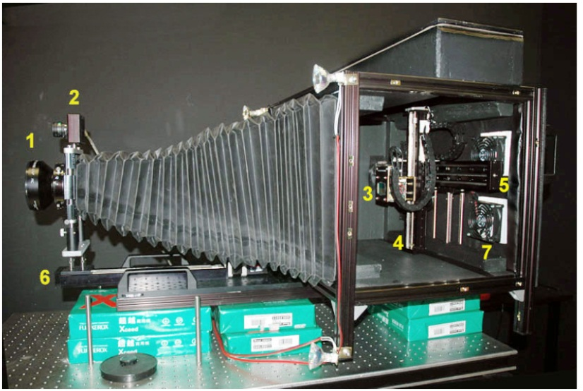
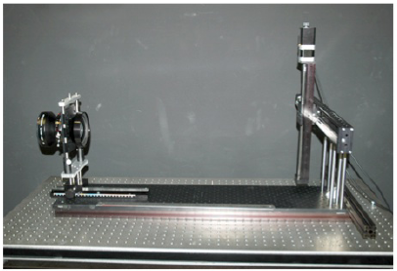
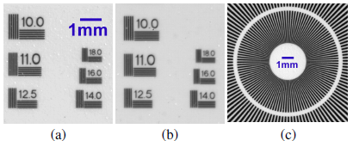
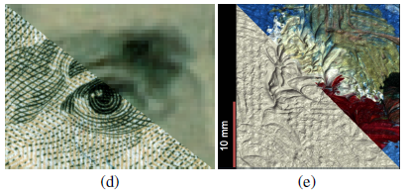
Giga-pixel Camera
Large-format lens
CCD
Giga-pixel Camera
@ Microsoft research
M. Ezra et al.

Slide 4
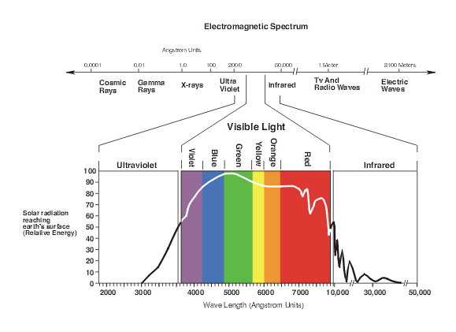
Spectrum

Slide 5
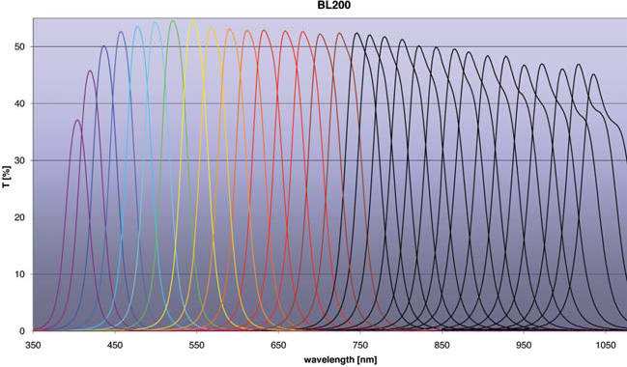
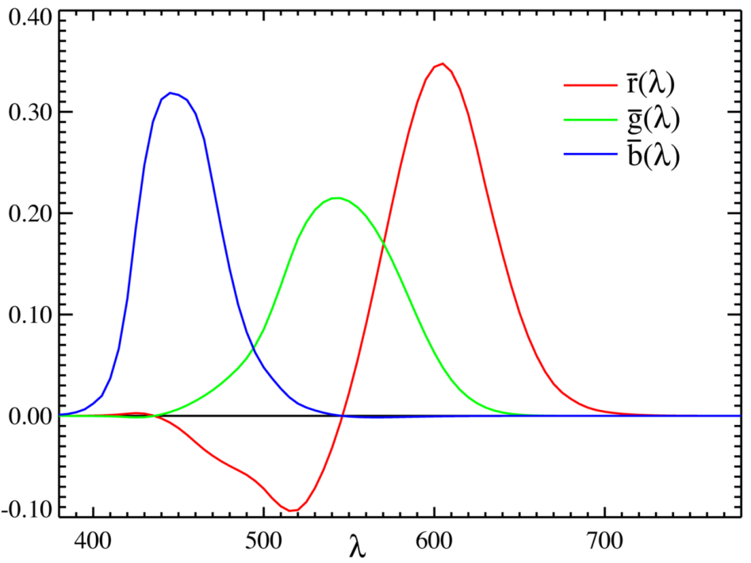
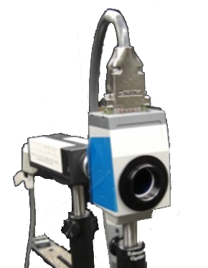

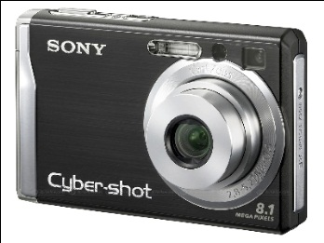
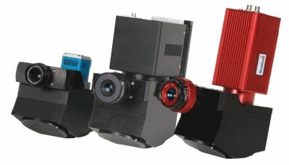
RGB vs. Spectrum

Slide 6
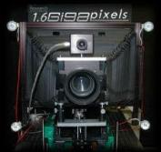


Approach
Combine
high-res
RGB
Low-res
hyperspectral
High-res
hyperspectral image

Slide 7






Problem formulation
Goal:
H
(Image height)
S
W
(Image width)
Given:

Slide 8

Representation: Basis function
H (Image height)
=
x 0
+
x 1.0
+
x 0
+
x 0
S
$$Z$$
W (Image width)
0
1.0
0
…
0
=
…

Slide 9
Two-step approach
Estimate basis functions from hyperspectral image
For each pixel in high-res RGB image, estimate coefficients for the basis functions

Slide 10





1: Limited number of materials
At each pixel $(i,j)$ of $Y_{hs}$, only a few ($≪hs$) materials are present
0
0.4
0
…
0.6
H (Image height)
=
…
S
W (Image width)
Sparse vector
For all pixel (i,j)
$$Y_{hs}$$
Sparse matrix

Slide 11
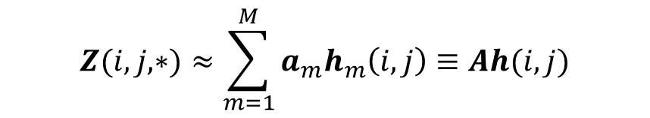





2: Sparsity in high-res image
H
S
Sparse coefficients
W
$$Y_{rgb}\left(i,j,∗\right)=𝒫_{rgb}Ah(i,j)$$
$$Y_{rgb}$$
Reconstruction
$$\hat{h}\left(i,j\right)=\arg{\min{{\left\|h\right\|}_{1}}}$$
$$subject to{\left\|Y_{rgb}\left(i,j,∗\right)−𝒫_{rgb}Ah\right\|}_{2}≤ε$$

Slide 12
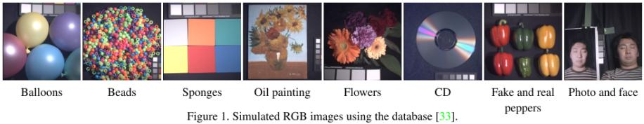
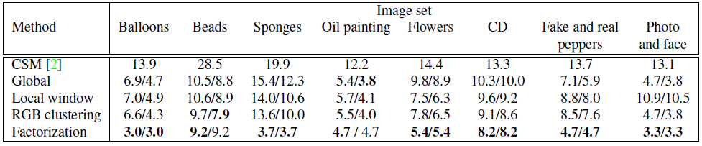
Simulation experiments

Slide 13
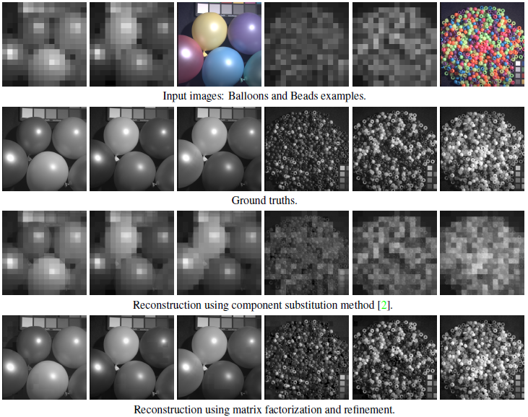
460 nm
550 nm
620 nm
460 nm
550 nm
620 nm

Slide 14
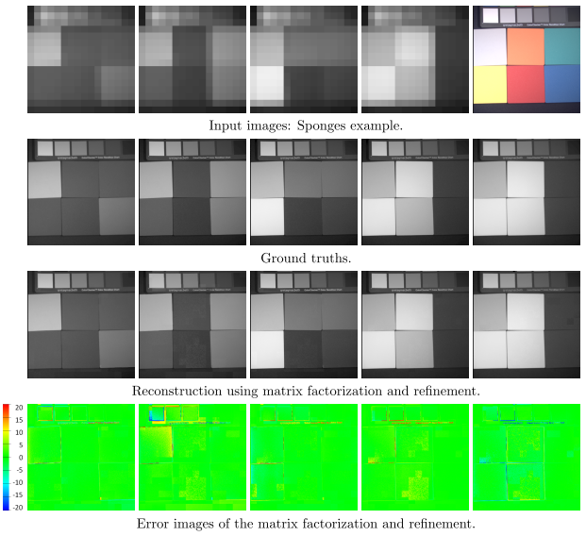
430 nm
490 nm
550 nm
610 nm
670 nm

Slide 15
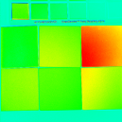
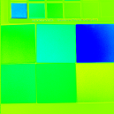
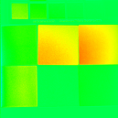

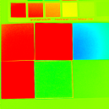
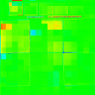
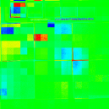
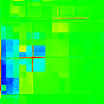
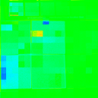
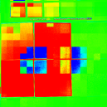


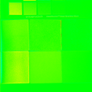
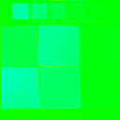
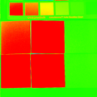
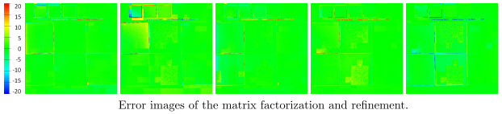
Error images of Global PCA with back-projection
Error images of local window with back-projection
Error images of RGB clustering with back-projection

Slide 16
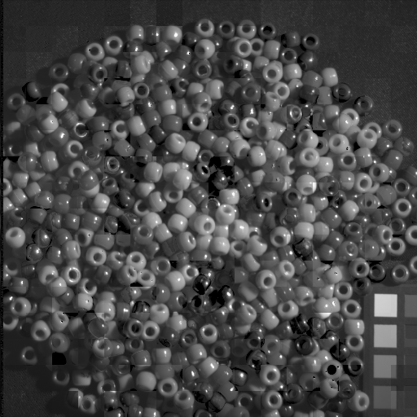
Estimated
430 nm

Slide 17
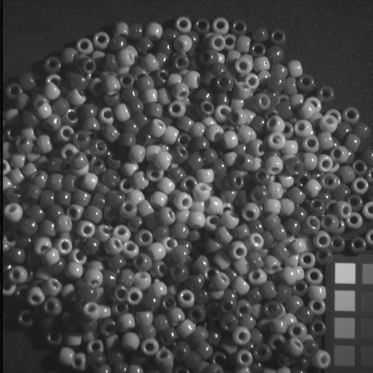
Ground
truth

Slide 18
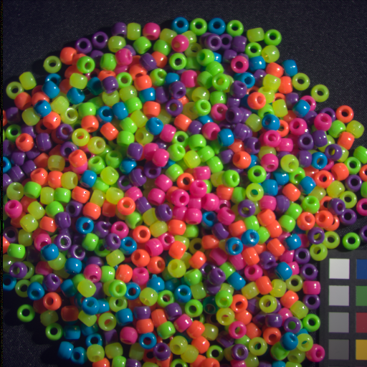
RGB
image

Slide 19
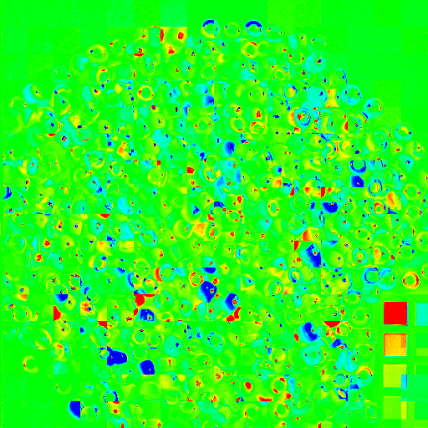
Error
image

Slide 20
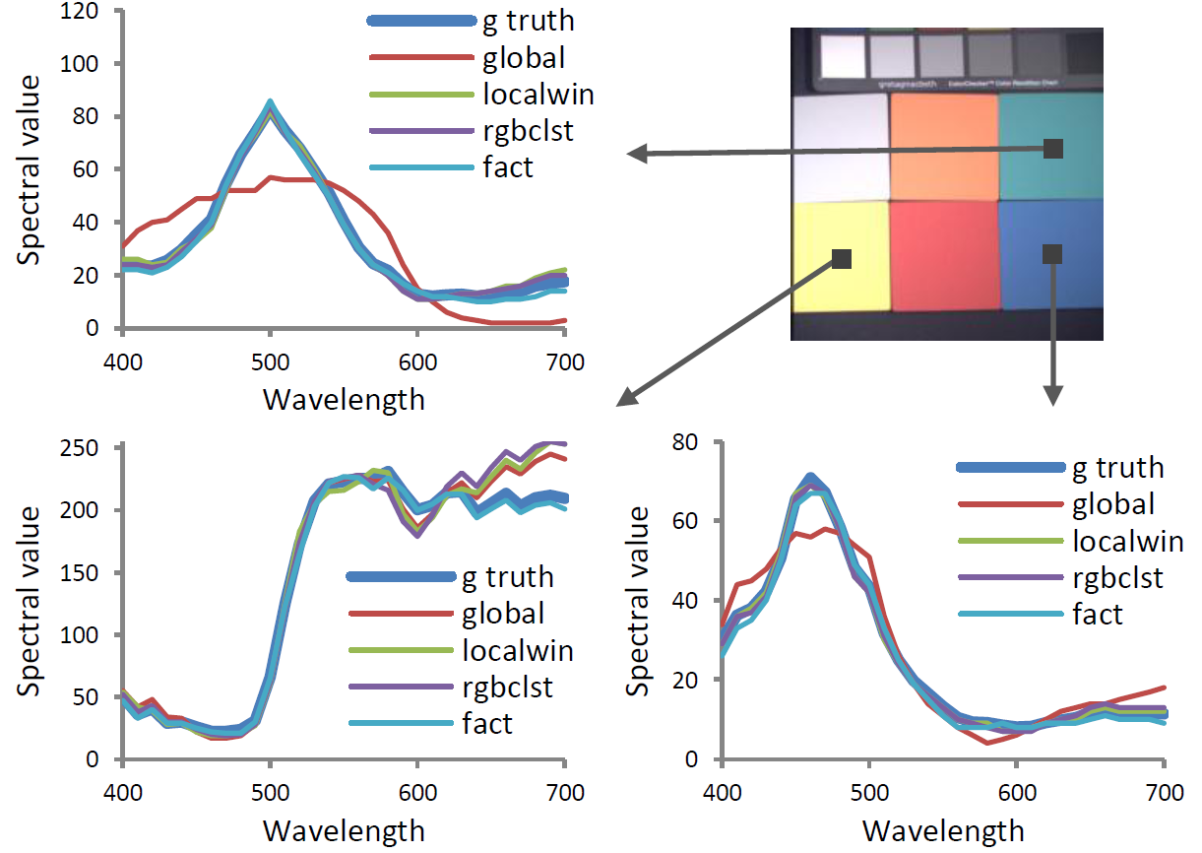

Slide 21
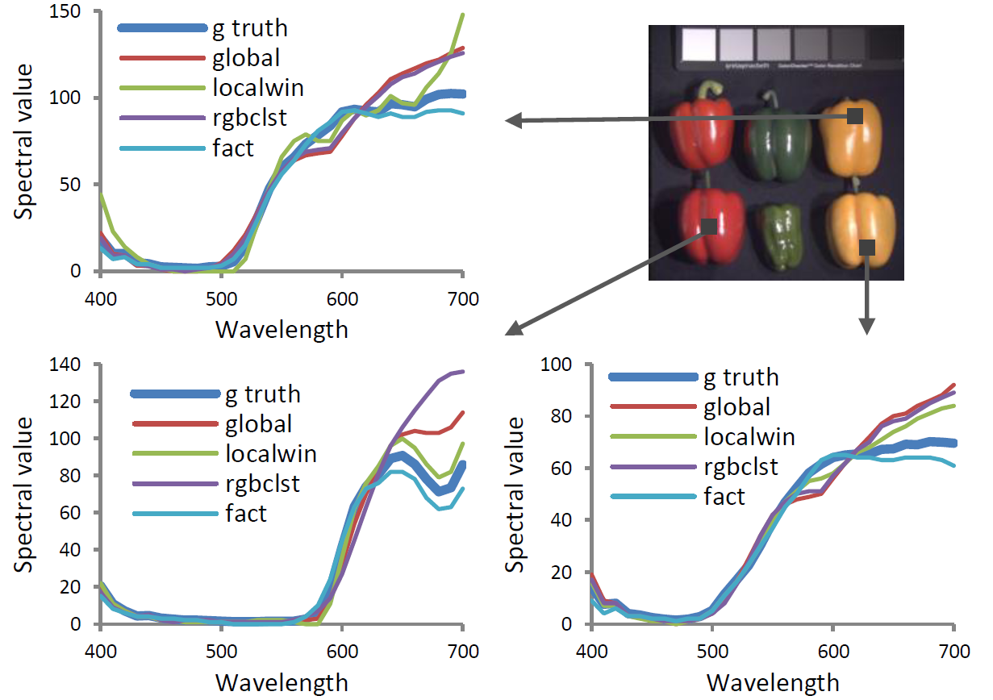

Slide 22
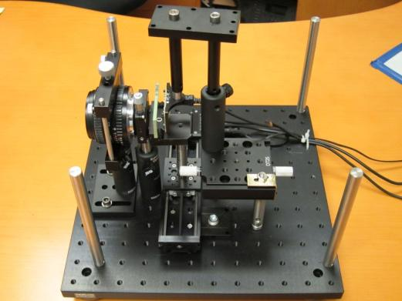
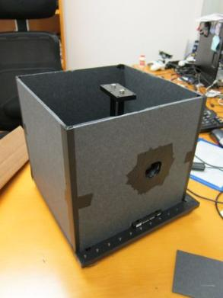
HS camera
Lens
Aperture
CMOS
Focus
Filter
Translational stage

Slide 23


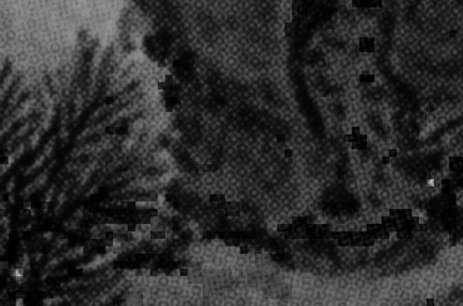

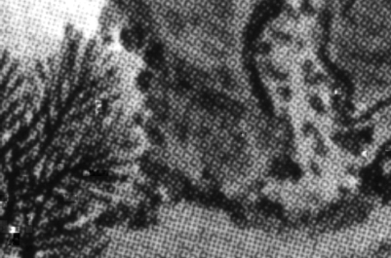

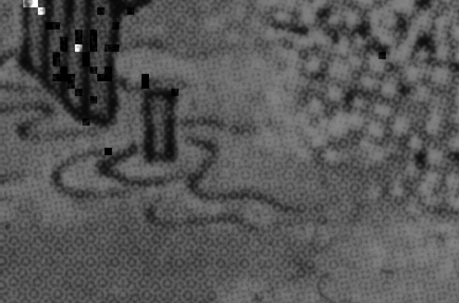

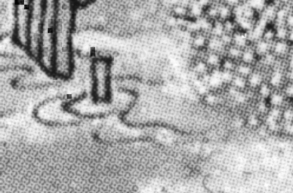
Real data experiment
Input RGB
Input (550nm)
Estimated (550nm)
Input (620nm)
Estimated (620nm)

Slide 24
Summary
Method to reconstruct high-resolution hyperspectral image from
  Low-res hyperspectral camera
  High-res RGB camera
Spatial sparsity of hyperspectral input
  Search for a factorization of the input into
    basis functions
    set of maximally sparse coefﬁcients
Notes:
Our approach include three key-points.
One is a novel physical model “Spider model”.
One is to estimate the optical properties using spider model.
One is simulation of appearances with various degrees of opacity.

