Slide 1



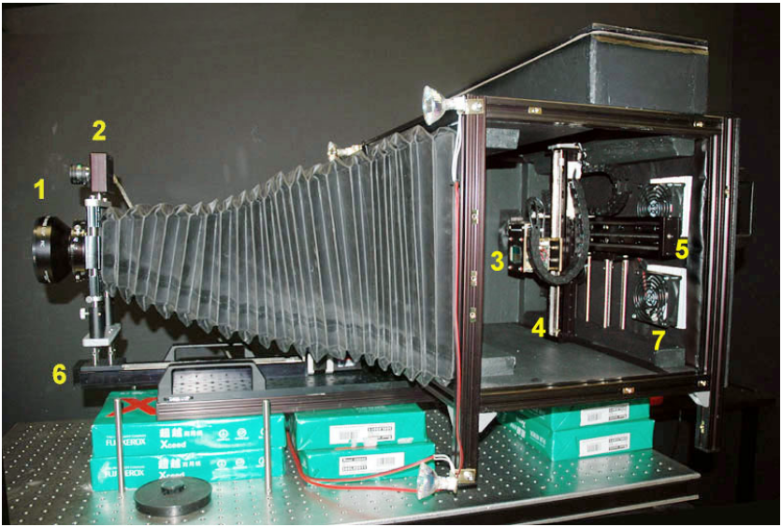
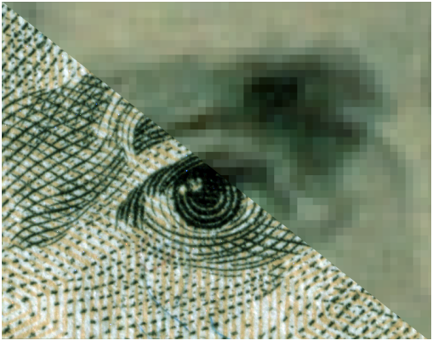
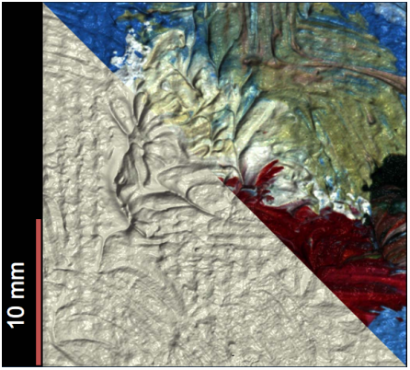
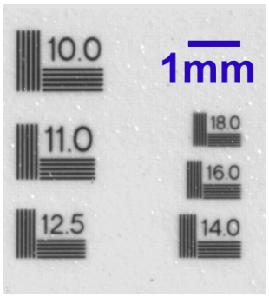




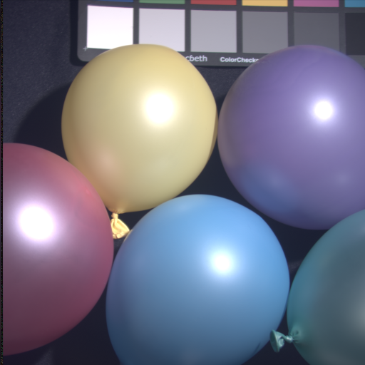


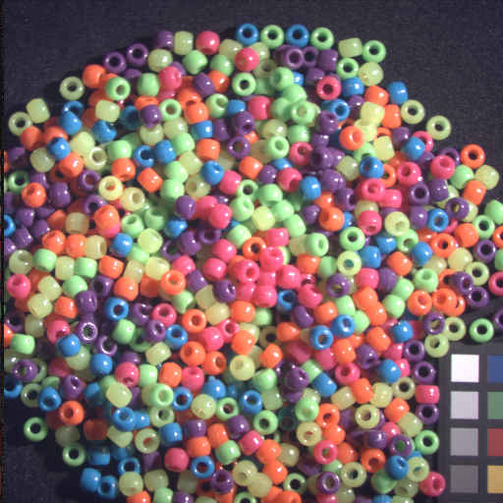
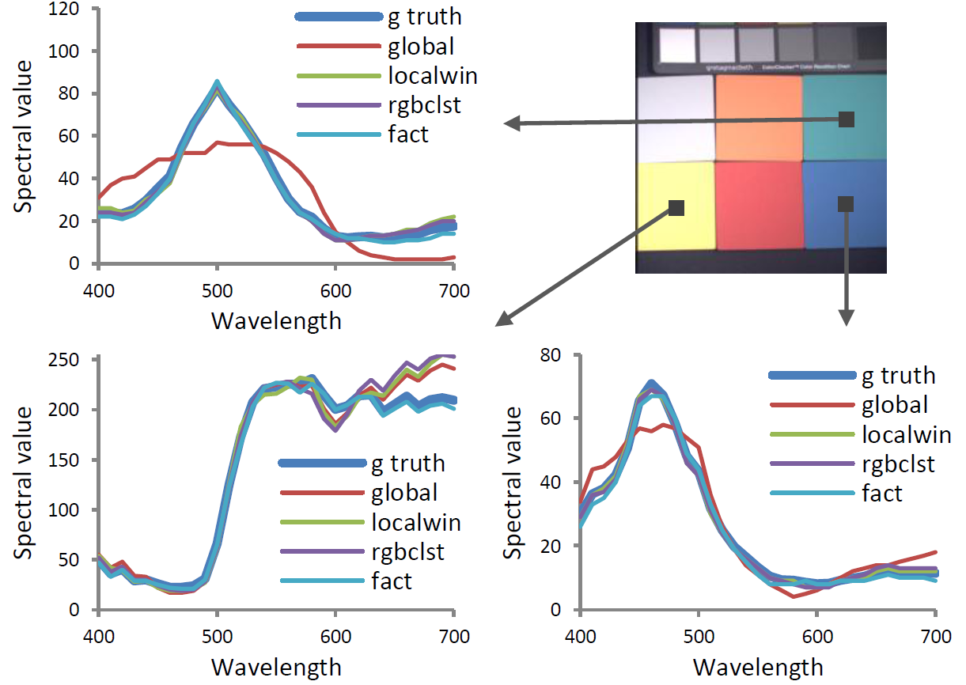
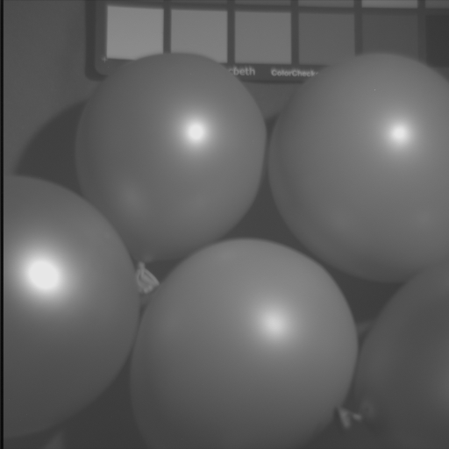
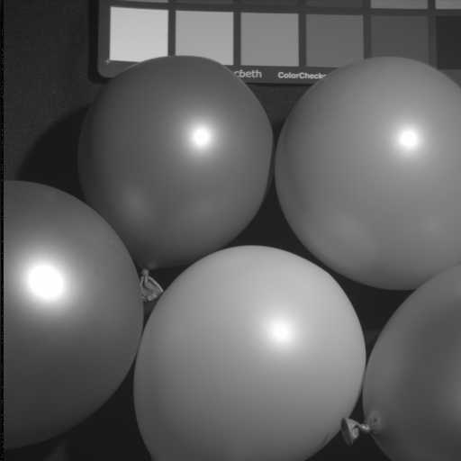
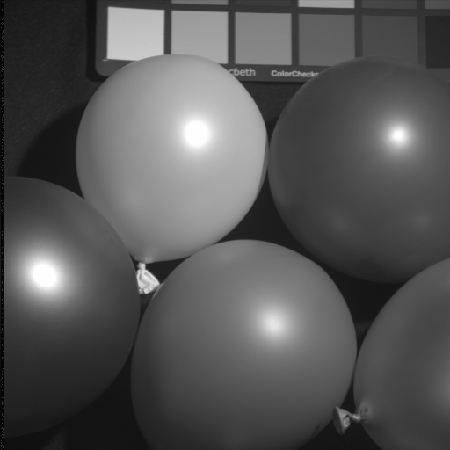
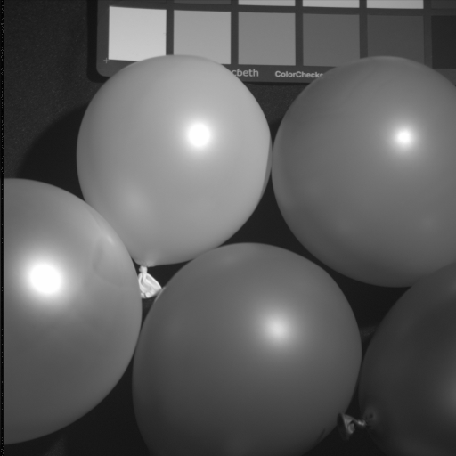
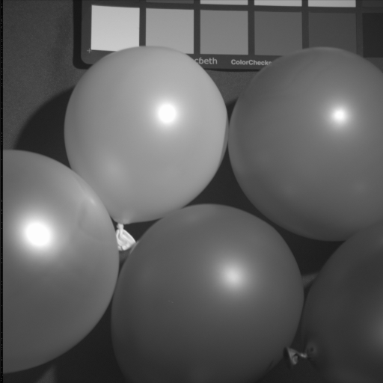
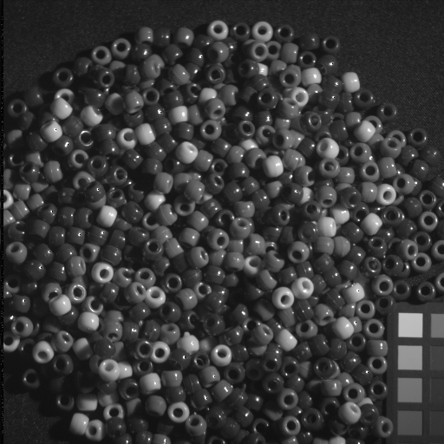
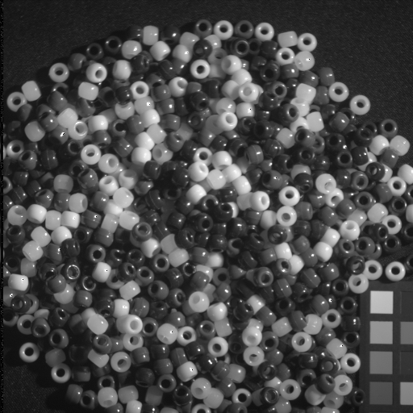
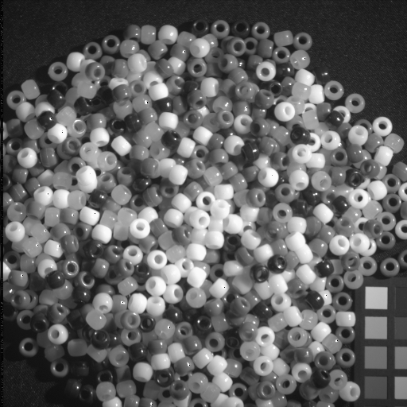
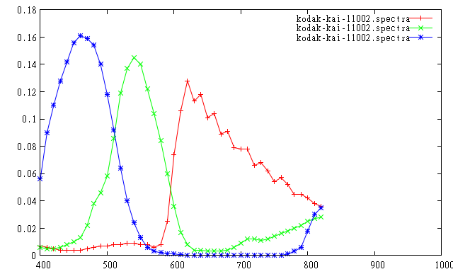
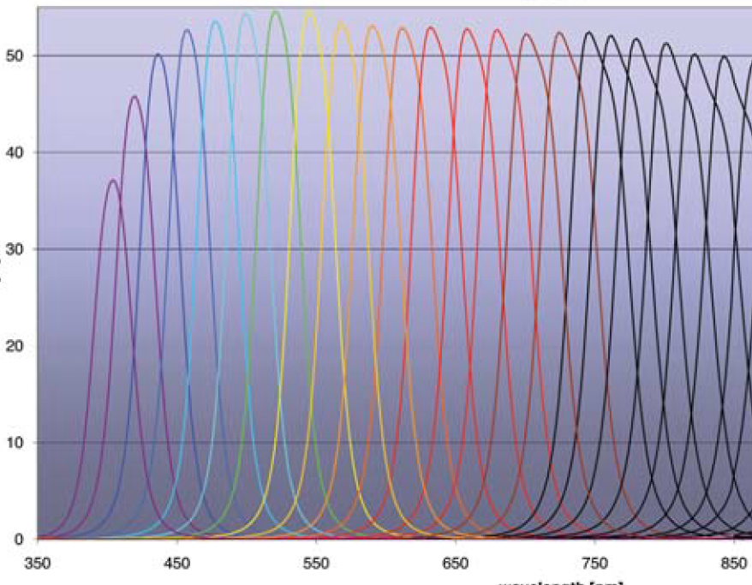
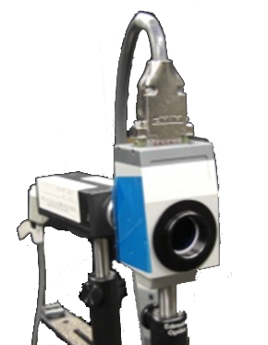
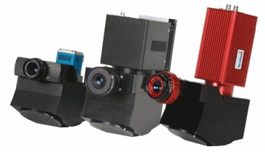
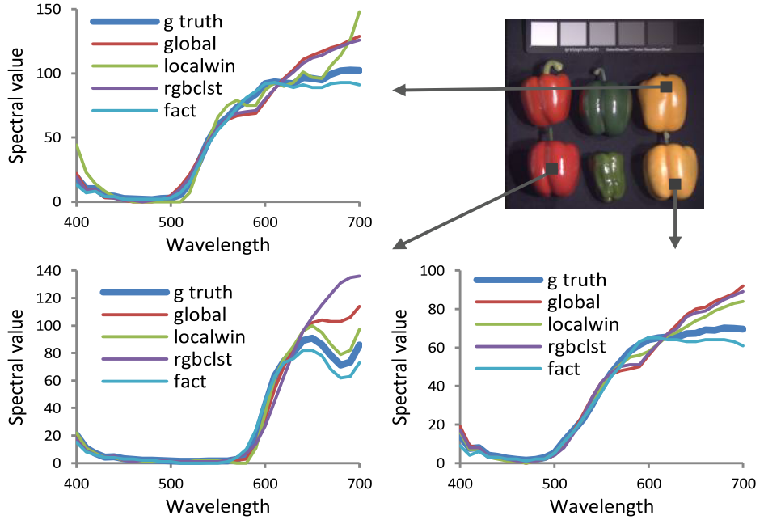
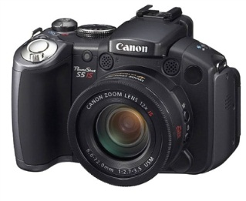
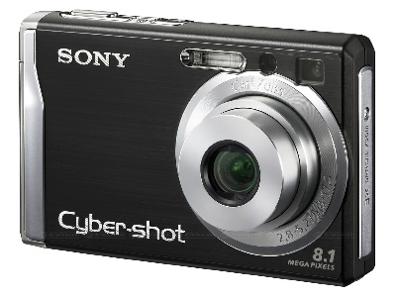

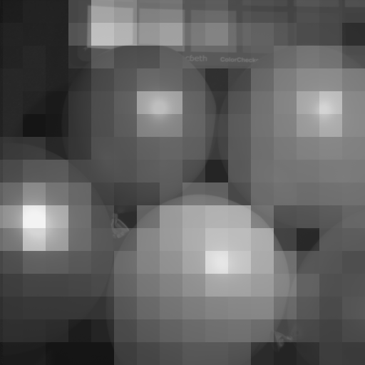
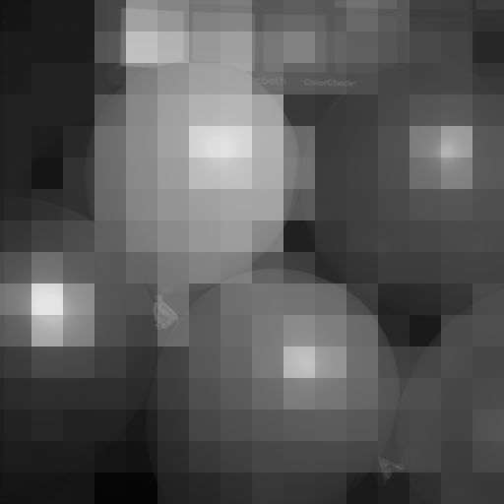
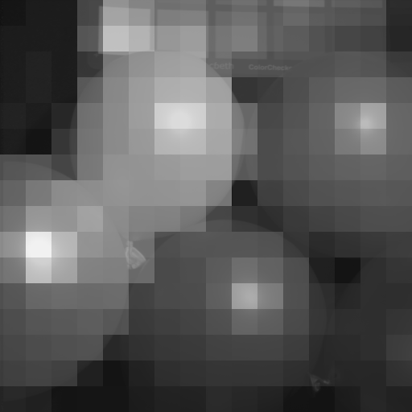

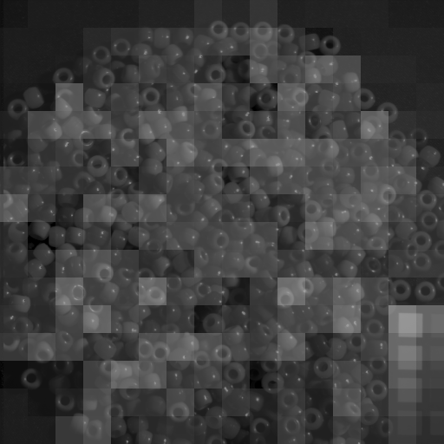
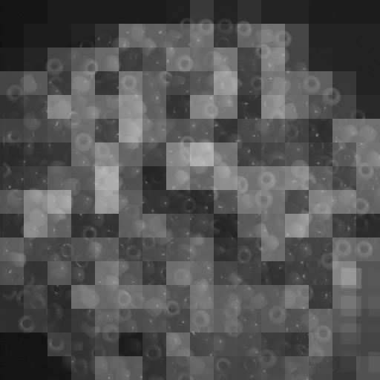
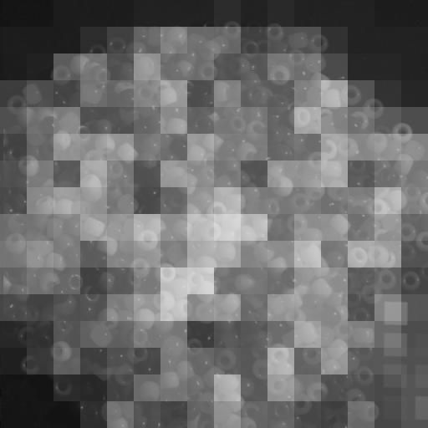
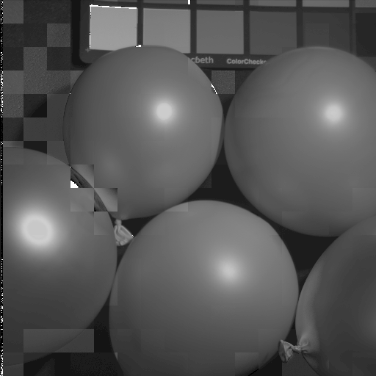
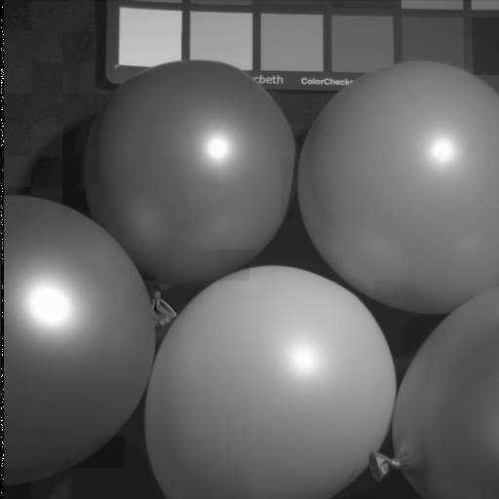
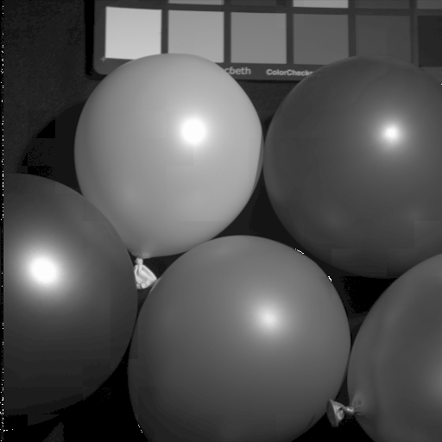

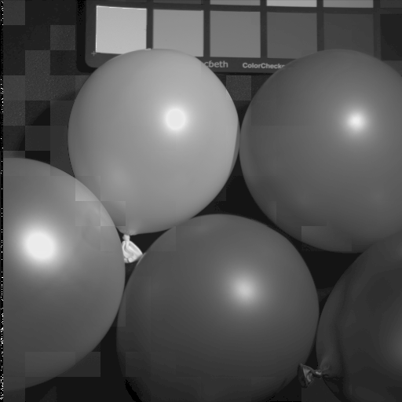
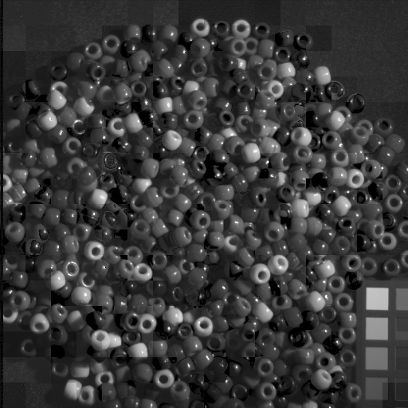
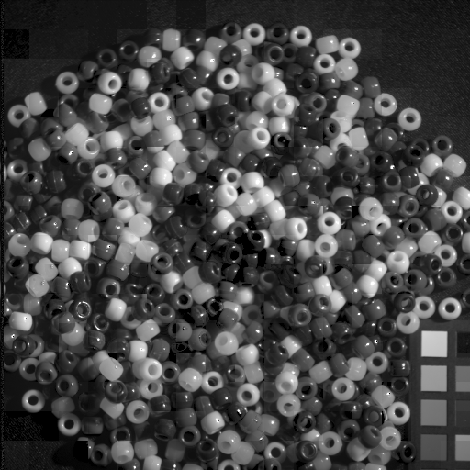

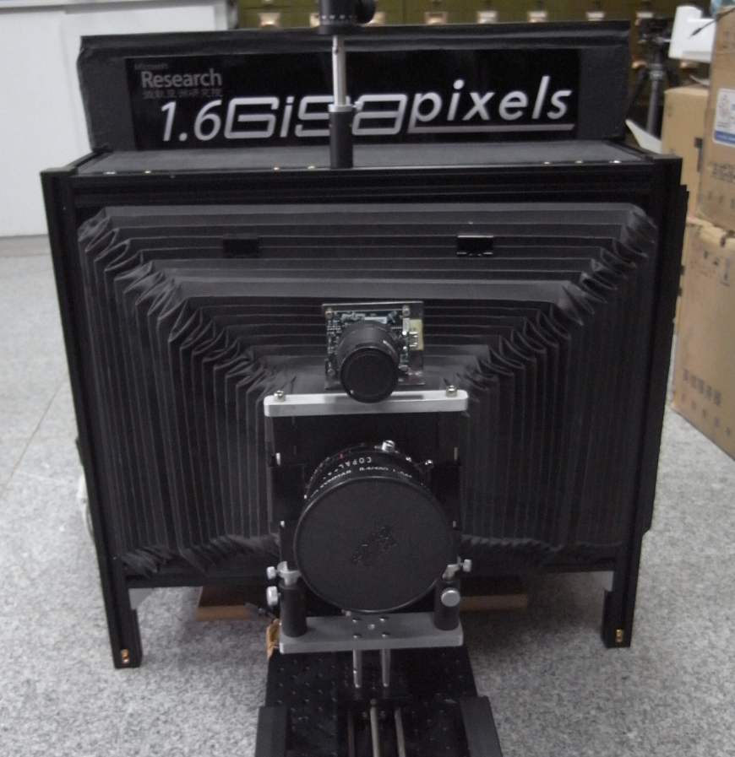
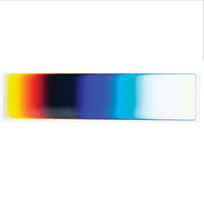
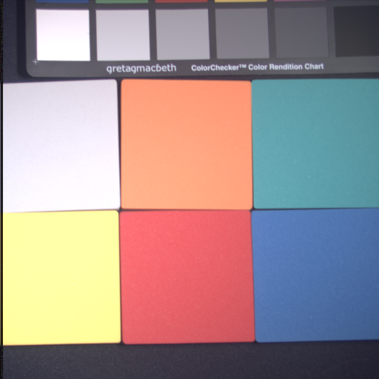
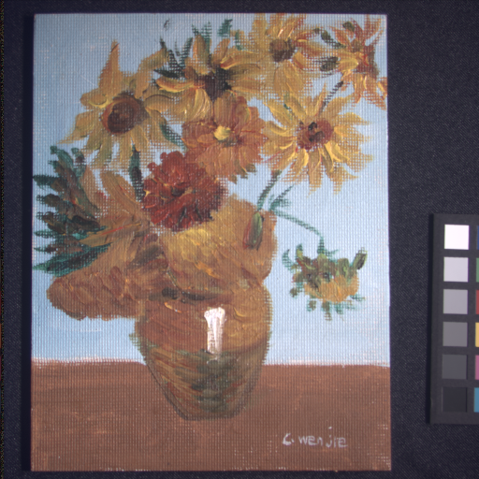
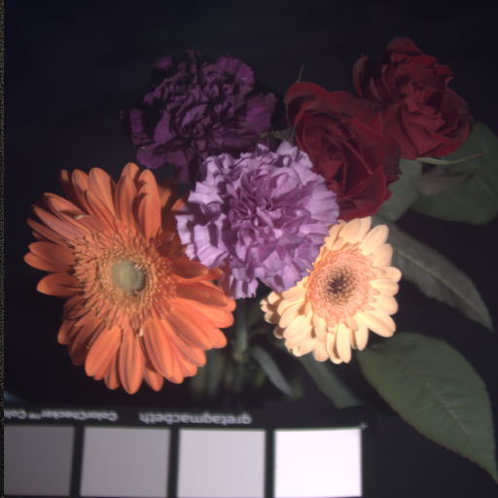
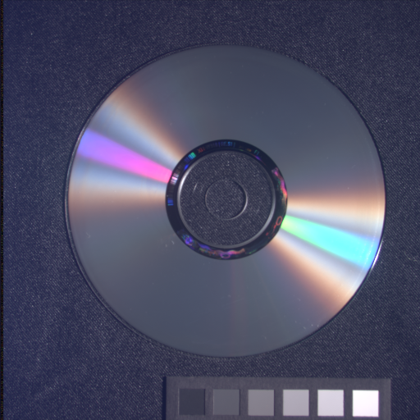
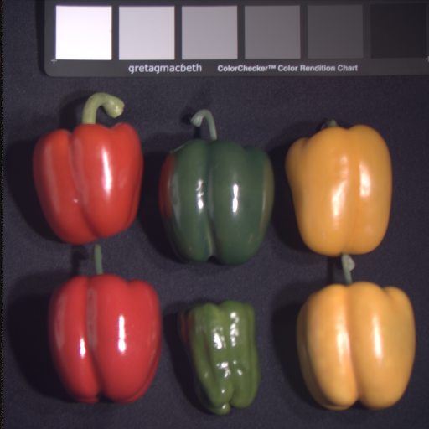
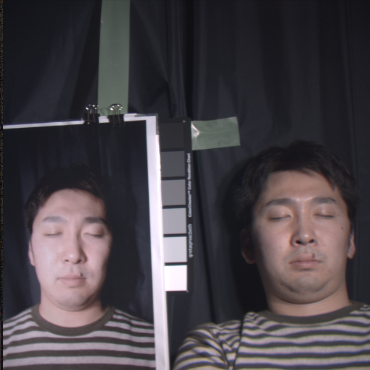
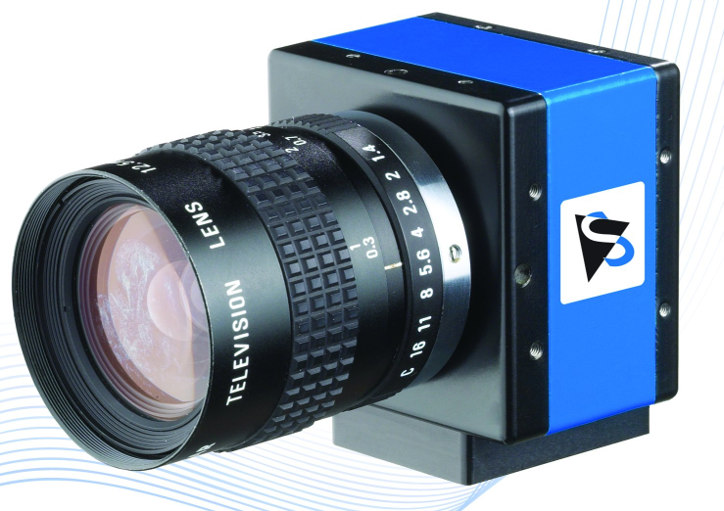
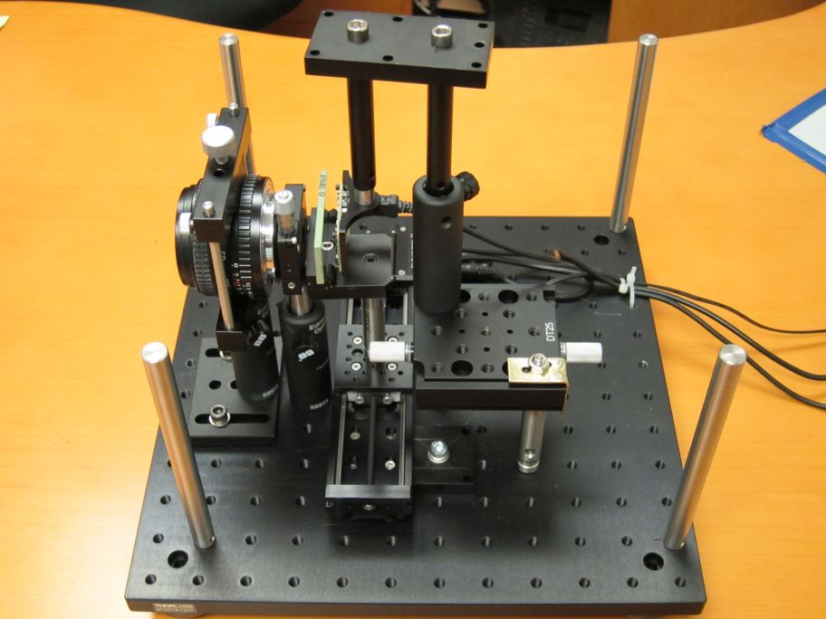
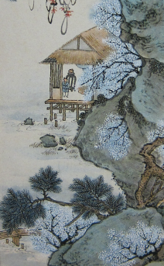

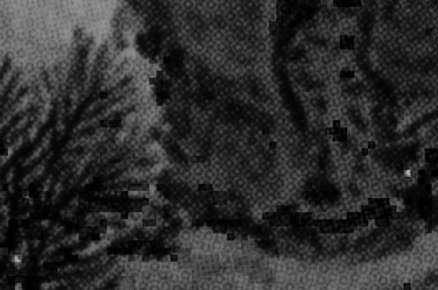

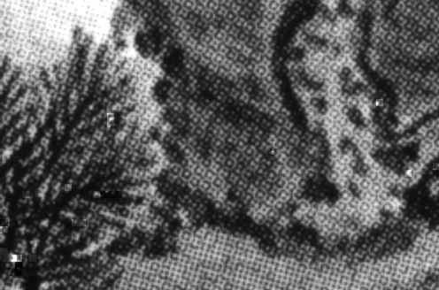

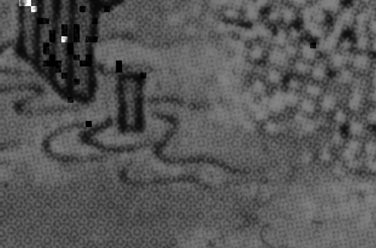

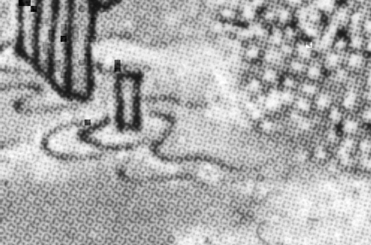


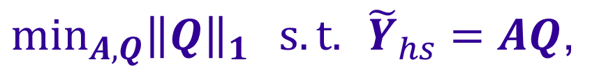








High-resolution Hyperspectral Imaging via Matrix Factorization
The University of Tokyo†
Microsoft Research Asia ‡
KAIST††
Rei Kawakami†
John Wright‡
Yu-Wing Tai††
Yasuyuki Matsushita‡
Moshe Ben-Ezra‡
Katsushi Ikeuchi†
Introduction
How can we obtain high-resolution hyperspectral information in an efficient manner?
Approach
Two step process
Estimate basis functions from hyperspectral image
For each pixel in high-res RGB image, estimate coefficients for the basis functions
Problem formulation
  Representation: Basis functions
  Given inputs
  Solution via $ℓ^{1}$ minimization
Experiments
  Simulation
  Real data
0.001
0.1
10
200
5000
[nm]
H (Image height)
0
1.0
0
…
0
400nm
470nm
560nm
670nm
RGB/700nm
460nm
550nm
RGB/620nm
Spectrum
=
x 0
+
x 1.0
+
x 0
+
x 0
=
…
S (Wavelength)
Input images: Balloons and Beads examples
High-resolution RGB camera ©Ben Ezra et al. (Microsoft)
200
300
400
500
600
700
1000
[nm]
W (Image width)
Reflectance of materials
(Basis functions)
Reflectance matrix
x coefficients
Spectral radiance
Ground truths
H
$$Y_{hs}∈ℝ^{w×h×S}$$
$$=℘_{hs}\left[Z\right]=$$
1
1
…
1
1
…
…
…
…
…
…
…
1
1
…
1
Reconstruction using component substitution method [2]
RGB camera spectral characteristic
Hyperspectral camera spectral characteristic
S
Hyperspectral image
1
…
W
$$Z∈ℝ^{W×H×S}$$
$$Y_{rgb}∈ℝ^{W×H×3}$$
$$=℘_{rgb}\left[Z\right]=$$
…
Reconstruction using matrix factorization method
Full resolution information
…
…
…
…
+
High-resolution
hyperspectral image
RGB image
…
Reconstruction error
Output
  Matrix factorization
  Assumption1: At each pixel $(i,j)$ of $Y_{hs}$, only a few ($≪hs$) materials are present
  ${\tilde{Y}}_{hs}=AQ$ (basis x sparse coefficient)
  Reconstruction
  Assumption2: At each pixel $(i,j)$ of $Z,$ materials should be even much fewer
Method | Balloons | Beads | Sponges | Oil painting | Flowers | CD | Peppers | Face
CSM[2] | 13.9 | 28.5 | 19.9 | 12.2 | 14.4 | 13.3 | 13.7 | 13.1
Global | 6.9/4.7 | 10.5/8.8 | 15.4/12.3 | 5.4/3.8 | 9.8/8.9 | 10.3/10.0 | 7.1/5.9 | 4.7/3.8
Local win | 7.0/4.9 | 10.6/8.9 | 14.0/10.6 | 5.7/4.1 | 7.5/6.3 | 9.6/9.2 | 8.8/8.0 | 10.9/10.5
RGB clust | 6.6/4.3 | 9.7/7.9 | 13.6/10.0 | 5.5/4.0 | 7.8/6.5 | 9.1/8.6 | 8.5/7.6 | 4.7/3.8
Proposed | 3.0/3.0 | 9.2/9.2 | 3.7/3.7 | 4.7/4.7 | 5.4/5.4 | 8.2/8.2 | 4.7/4.7 | 3.3/3.3
High-res RGB
Low-res hyperspectral
Inputs
0
0.4
0
…
0.6
=
…
$$Z\left(i,j,∗\right)≈Ah\left(i,j\right)$$
Sparse
RMSE before/after post-processing Bold: best score
Sparse
$$Y_{rgb}\left(i,j,∗\right)=℘_{rgb}[Ah\left(i,j\right)]$$
Lens
Variable filter
Find the sparsest coefficents
Board camera
References
[1] Q. Geng, H. Wang and J. Wright. On the local correctness of L1 minimization for dictionary learning. Preprint. http://arxiv.org/abs/1101.5672, 2011.
[2] B. Aiazzi, S. Baronti and M. Selva. Improving component substitution pansharpening through multivariate regression of ms+pan data. IEEE Trans. Geoscience and Remote Sensing, 2007.
Reconstruction
$\min_{A,Q}{{\left\|Q\right\|}_{1}} s.t.$ ${\tilde{Y}}_{hs}=AQ\text{,}$
$$\hat{h}\left(i,j\right)=\arg{\min{{\left\|h\right\|}_{1}}}$$
Adjustable slit
Translation stage
Acknowledgement
This work was in part supported by Microsoft Research CORE 6 Project 2010.
${\left\|Ae_{i}\right\|}_{2}=1$ $∀_{i}$
$$s.t. {\left\|Y_{rgb}\left(i,j,∗\right)−℘_{rgb}[Ah]\right\|}_{2}≤ε$$
Input RGB
Input (550nm)
Estimated (550nm)
Input (620nm)
Estimated (620nm)

